Slide 1
Algorithms and Data Structures (CIS1002-N)
Week 3: Sorting Algorithms
Selection Sort and Insertion Sort
Module Leader: Dr Annalisa Occhipinti
Email: A.Occhipinti@tees.ac.uk

Slide 2
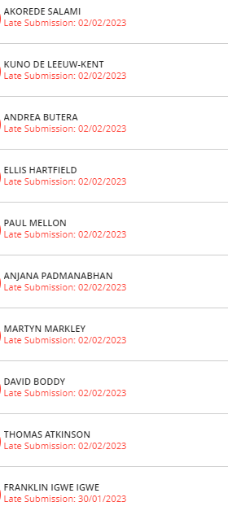
Quiz 2
Well done!

Slide 3
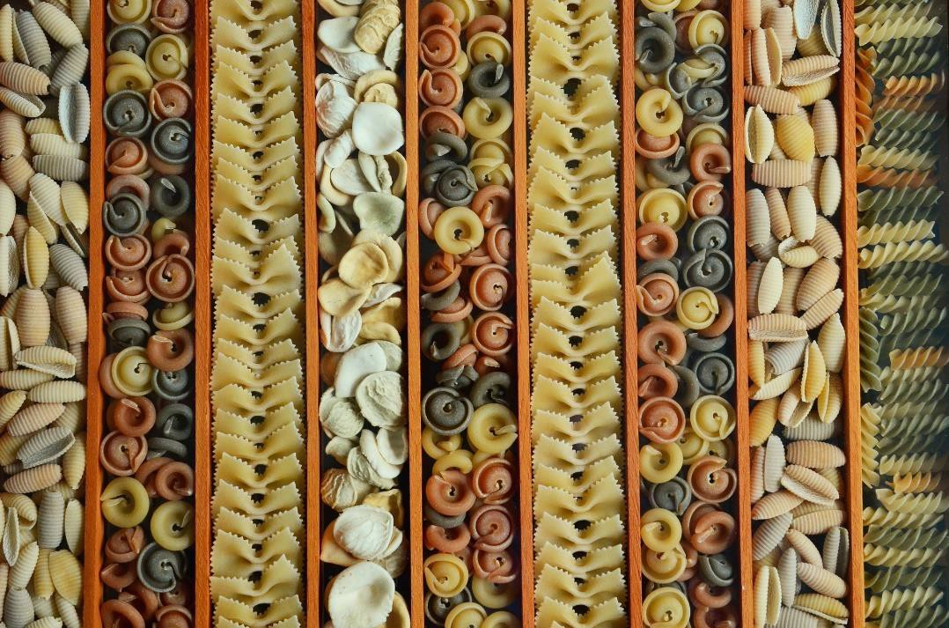
Todays’ Topic
More sorting algorithms…Selection Sort and Insertion Sort
Rote memorisation of the algorithms is not enough. If you just try to memorise them, you won’t score highly in this module.
Instead, we need to gain a deep understanding of the pros and cons of each of these algorithms, as well as how they can be implemented and optimised!

Slide 4
Starter – In groups of 2 or 3…
1) Write the Java code for the method to find the minimum value of the array below:
a = {5, 6, 4, 1, 3} a.length = 5
2) Then, write the Java code to find the minimum value of the sub-array {4,1,3},
which is the array made of the items at index 2, 3 and 4 in a.
3) How would you change the method findMinSubarray to return the index of the minimum value?
Public void findMin(int[] a){
}
Public void findMinSubarray(int[] a, int start, int end){
}

Slide 5
Selection Sort

Slide 6
Selection Sort
Basic definition:
find the smallest element
put it in the first position
find the next smallest element
put it in the second position
… repeat for the rest of the array

Slide 7
Selection Sort
Find the index of the smallest item (minimum) and place it at index 0
Start at the left end.
Mark the leftmost item, as min.
Compare this item with the next item, the smallest of the two now becomes min.
Keep comparing until the end, the final min item is swapped and placed at position 0.
Then start with position 1 and repeat the process.
Increase the index and repeat the process
a:
11
12
7
5
0
1
2
3

Slide 8
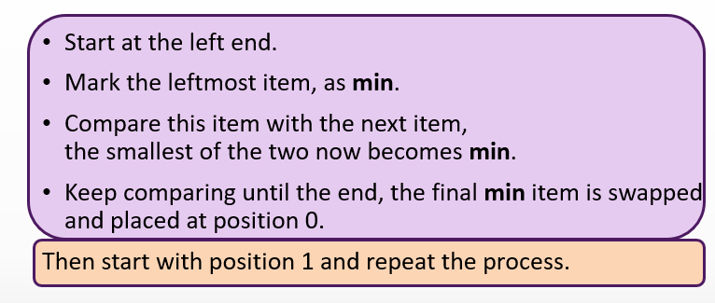
Demo
a:
11
12
7
5
0
1
2
3

Slide 9
Example
count posmin
a:
19
12
7
5
5
0 3
0
1
2
3
a:
5
12
7
1 2
7
19
0
1
2
3
a:
5
7
12
19
2 2
12
0
1
2
3
a:
5
7
12
19
3 3
19
0
1
2
3
a:
5
7
12
19
4 3
0
1
2
3

Slide 10
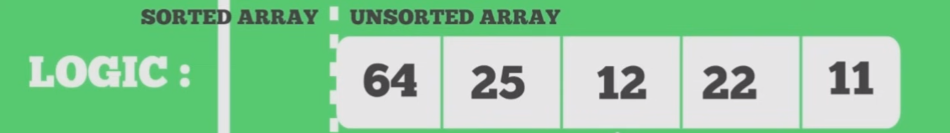
Basic Idea…

Slide 11
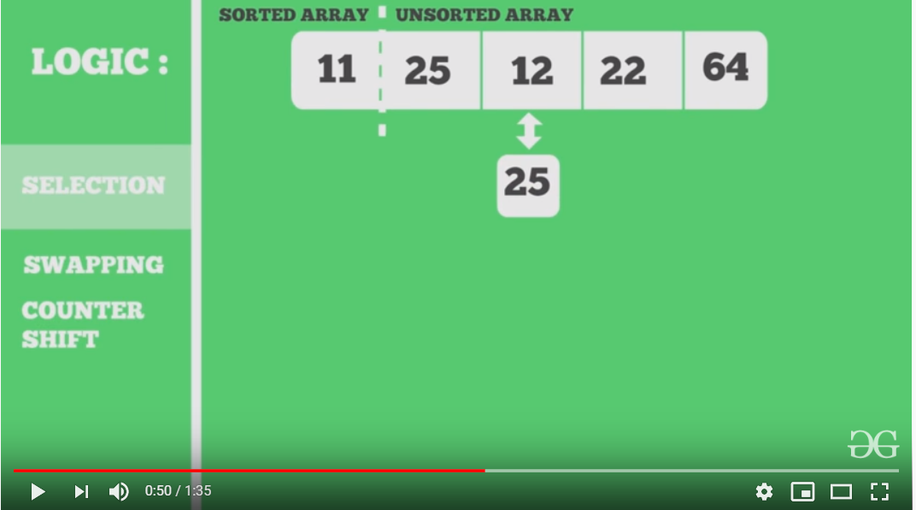
Visual Example

Slide 12
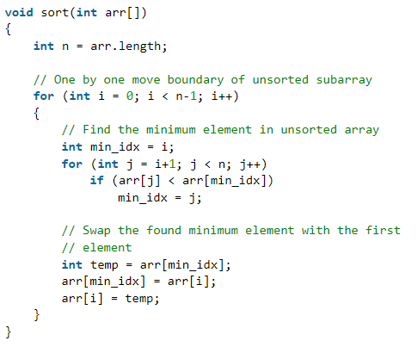
Selection Sort - Demo
arr:
8
3
9
6
0
1
2
3
Steps:
1. select the smallest element
among data[i+1] → data[data.length-1]
2. swap it with data[i];
3. if not finished, repeat 1 & 2

Slide 13
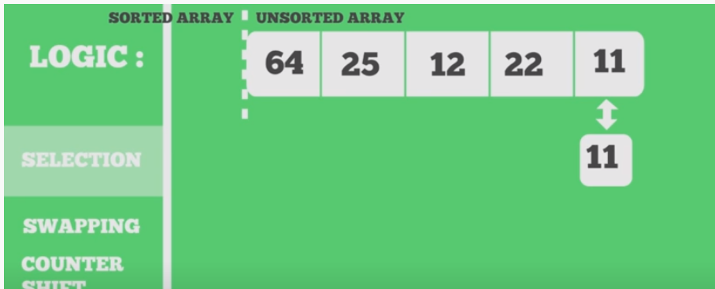
Analysis of Selection Sort
Comparison with Bubble Sort
How many swaps in total? n(n-1)/2
The number of swaps is considerably reduced. Faster than bubble sort because of fewer swaps.
?

Slide 14
Your Turn
Draw a step-by-step trace of the Selection Sort algorithm for the following array
7 | 6 | 1 | 5 | 3 | 4

Slide 15
Insertion Sort

Slide 16
Insertion Sort - Definition
a:
9
2
5
3
Basic definition:
Start by considering the first two elements of the array data, if out of order, swap them
Consider the third element, insert it into the proper position among the first three elements.
Consider the fourth element, insert it into the proper position among the first four elements.
Repeat until the full array is sorted
Another definition:
Take the first unsorted item (assuming that the portion of the array in front of this item is sorted),
Insert the item in the correct position in the sorted part of the array
0
1
2
3

Slide 17
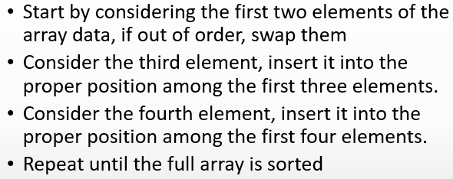
Demo
a:
19
12
5
7
0
1
2
3

Slide 18
Example
a:
19
12
5
7
0
1
2
3

Slide 19
Example – step 1
a:
19
12
5
7
compare
0
1
2
3
a:
19
12
19
5
7
shift (i.e. copy)
0
1
2
3
a:
12
19
19
5
7
insert
0
1
2
3
a:
12
19
5
7
0
1
2
3

Slide 20
Example – step 2
a:
12
19
5
7
0
1
2
3
a:
12
19
19
5
7
0
1
2
3
a:
12
19
12
19
7
0
1
2
3
a:
12
5
12
19
7
0
1
2
3
a:
5
12
19
7
0
1
2
3

Slide 21
Example – step 3
a:
5
12
19
7
0
1
2
3
a:
5
12
19
7
19
0
1
2
3
a:
5
12
12
19
19
0
1
2
3
a:
5
12
7
12
19
0
1
2
3
a:
5
7
12
19
0
1
2
3

Slide 22
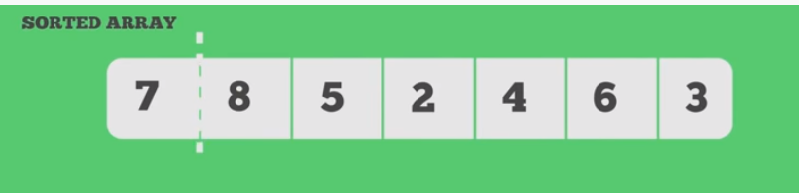
Insertion Sort
Assume that the first item in the array is sorted – sorted array.
The item on the right of the sorted sub-array is “marked”.
Compare this item with each of the items in the sorted sub-array
shifting the elements in the sorted sub-array one position to the right if the “marked” item is smaller.
This process is repeated till the appropriate position for the item is found.
The “marked” item is now inserted
This continues till all the unsorted items are inserted.

Slide 23
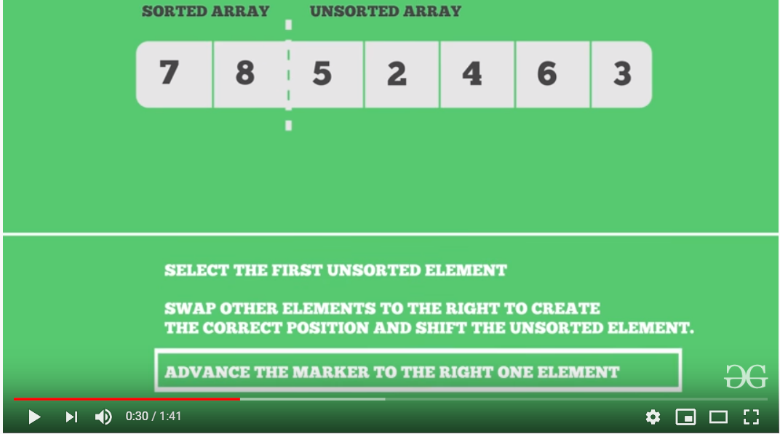
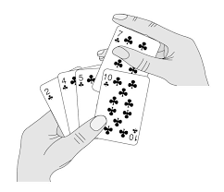
Visual Example
Real-life application:
Sorting cards

Slide 24
Insert Action: i=1
marker
8
20
8
5
10
7
i = 1, first iteration
8
20
20
5
10
7
---
8
20
5
10
7
Notes:
Copy the one to be inserted in some temporary storage !

Slide 25
Insert Action: i=2
marker
5
8
20
5
10
7
i = 2, second iteration
5
8
20
20
10
7
5
8
8
20
10
7
---
5
8
20
10
7

Slide 26
Insert Action: i=3
marker
10
5
8
20
10
7
i = 3, third iteration
10
5
8
20
20
7
---
5
8
10
20
7

Slide 27
Insert Action: i=4
marker
7
5
8
10
20
7
i = 4, fourth iteration
7
5
8
10
20
20
7
5
8
10
10
20
7
5
8
8
10
20
---
5
7
8
10
20

Slide 28
Quick Question
Using the data provided in the following array [8, 3, 9, 6, 5, 3],
Draw a step-by-step trace of the Insertion Sort algorithm.

Slide 29
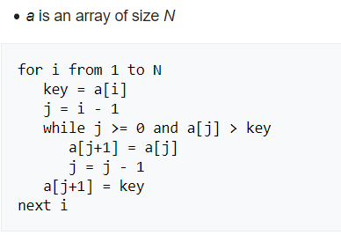
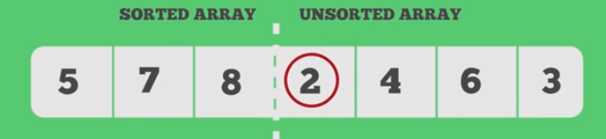
Pseudo-code for Insertion Sort
Place i^{th} item in its proper position:
marker = data[ i ]
shift those elements data[ j ] which are greater than marker to right by one position
place marker in its proper position
-1

Slide 30
Pseudo-code for Insertion Sort
Start with the item at index 1 (marker)
Compare this item with each of the items on its left (sorted sub-array)
shift the elements in the sorted sub-array one position to the right if the “marker” item is smaller.
This process is repeated till the appropriate position for the item is found.
The “marker” item is now inserted
This continues till all the unsorted items are inserted.
- 1

Slide 31
Your Turn
Draw a step-by-step trace of the Insertion Sort algorithm for the following array
7 | 6 | 1 | 5 | 3 | 4

Slide 32
Which algorithm should I use?
Bubble sort is useful for small amounts of data (and you would expect low number of swaps, maybe because the array is partially sorted).
Selection sort can be used when the amount of data is small and swapping is time-consuming.
Insertion sort is the most “flexible” and the best when the list is almost sorted.

Slide 33
Quizizz

Slide 34
Summary
https://www.toptal.com/developers/sorting-algorithms

Slide 35
This week’s Lab session
Working on the Java code of sorting algorithms

Slide 36
Homework:
Show the steps of Selection sort using the array below.
A= {3, 7, 4, 0, 1, 5}
You can do this on a paper and upload a picture of your working out

